Slide 1





Consumer Goods
AD-HOC Insights

Slide 2






This Project is a part of codebasics challenge, Analysis of “Atliq hardware” by running AD-HOC queries.
Analyze the operational data of a hardware store and extract valuable insights to support decision-making and strategic planning and fulfill the requests asked by the Executive Management in the consumer Goods Domain.
To conduct the analysis, we utilized SQL queries to extract, transform, and analyze data. SQL provided a powerful and flexible toolset for querying large datasets and performing complex calculations.
The Data set is provided by Codebasics.
Project overview

Slide 3

Atliq Hardware is one of the leading computer hardware producers in India and well expanded in other countries too.
Atliq produces Hardware to 2 types of business :
Brick & mortar like Croma and Best buy.
E-commerce like Amazon and Flipkart.
These are Referred as Platforms.
When these platforms sell the products to end consumers they do it through channels.
When Platforms sells the products to consumers its Called “Retailer” channel.
When Atliq sells the products to consumers Directly its called “Direct” channel.
When Atliq sells products to out of country(India) they do it through distributor in that particular country.
Hence, in this case the channel is called “Distributor”.
So, for Atliq Hardware the customers are the sources to which they are selling the products directly.
Atliq Hardware
Atliq Hardware is a company that manufactures and sells hardware like, Keyboard, mouse and many more.

Slide 4

The Data is provided by Codebasics
Data Overview
It includes information for six main tables.
1. dim_customer: contains customer-related data
2. dim_product: contains product-related data
3. fact_gross_price: contains gross price information for each product
4. fact_manufacturing_cost: contains the cost incurred in the production of each product
5. fact_pre_invoice_deductions: contains pre-invoice deductions information for each product
6. fact_sales_monthly: contains monthly sales data for each product.

Slide 5
Keywords
Fiscal Quarters
Gross Sales
Fiscal Year
A fiscal year (FY) is a period used for financial reporting and planning by businesses, governments, and other organizations.
Unlike the calendar year, which begins on January 1st and ends on December 31st, a fiscal year can start and end at any point in the year, depending on the organization's accounting practices and reporting requirements.
Atliq’s Fiscal Year starts September Month
A fiscal year is typically divided into four quarters, each consisting of three months. Quarters provide a convenient way to track and analyze financial performance over shorter intervals within the fiscal year.
Gross sales refer to the total revenue generated by a business from selling its products or services before deducting any expenses, discounts, or returns. It represents the total value of all goods or services sold during a specific period.
Gross sales are calculated by multiplying the quantity of goods or services sold by their respective selling prices.

Slide 6
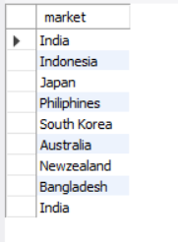
1. Provide the list of markets in which customer "Atliq Exclusive" operates its business in the APAC region.

Slide 7
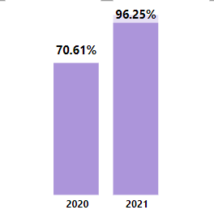
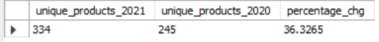
2. What is the percentage of unique product increase in 2021 vs. 2020? The final output contains these fields, unique_products_2020 unique_products_2021 percentage_chg

Slide 8
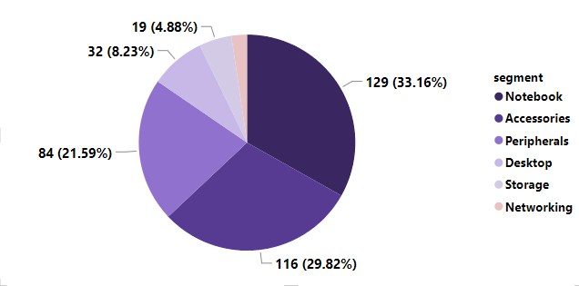
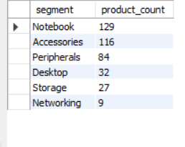
3. Provide a report with all the unique product counts for each segment and sort them in descending order of product counts. The final output contains 2 fields, segment product_count

Slide 9
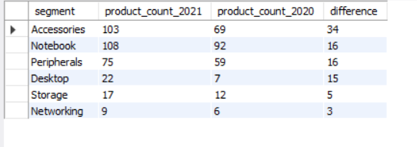
4. Which segment had the most increase in unique products in 2021 vs 2020? The final output contains these fields, segment product_count_2020 product_count_2021 difference

Slide 10
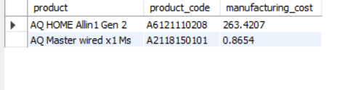
5. Get the products that have the highest and lowest manufacturing costs. The final output should contain these fields, product_code product manufacturing_cost

Slide 11
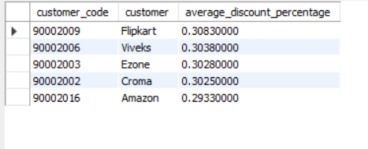
6. Generate a report which contains the top 5 customers who received an average high pre_invoice_discount_pct for the fiscal year 2021 and in the Indian market. The final output contains these fields, customer_code customer average_discount_percentage

Slide 12
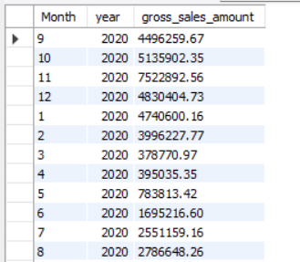
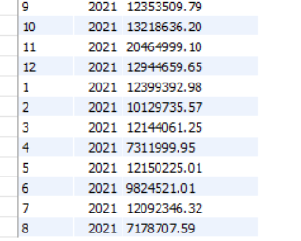
7. Get the complete report of the Gross sales amount for the customer “Atliq Exclusive” for each month . This analysis helps to get an idea of low and high-performing months and take strategic decisions. The final report contains these columns: Month Year Gross sales Amount

Slide 13
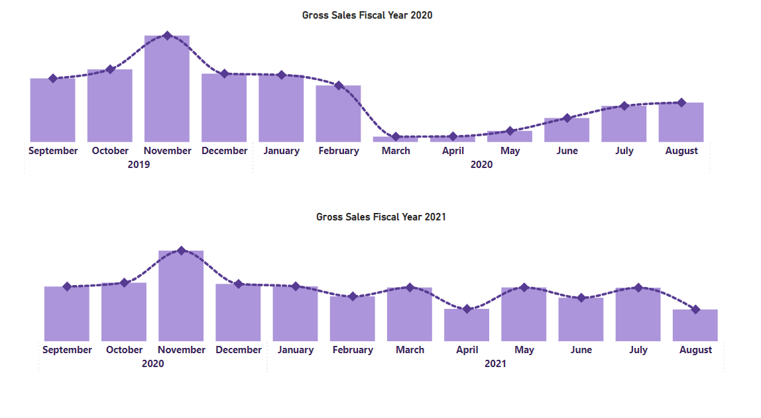



Slide 14
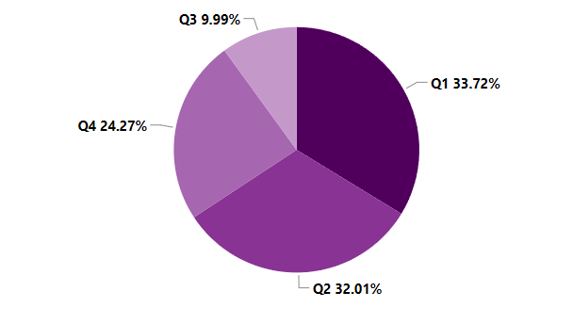
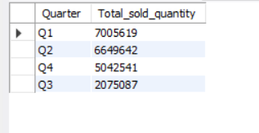
8. In which quarter of 2020, got the maximum total_sold_quantity? The final output contains these fields sorted by the total_sold_quantity, Quarter total_sold_quantity

Slide 15
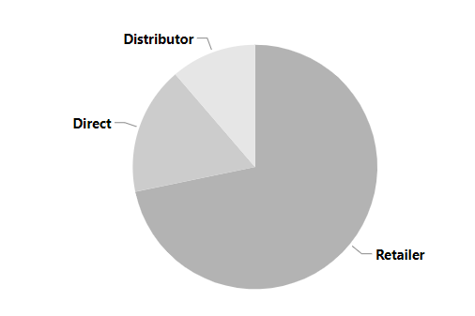
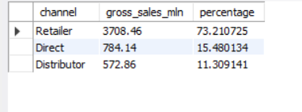
9. Which channel helped to bring more gross sales in the fiscal year 2021 and the percentage of contribution? The final output contains these fields, channel gross_sales_mln percentage

Slide 16
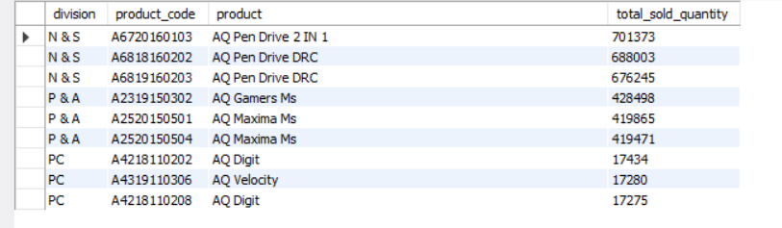
10. Get the Top 3 products in each division that have a high total_sold_quantity in the fiscal_year 2021? The final output contains these fields, division product_code product total_sold_quantity rank_order

Slide 17
Conclusion
In conclusion, SQL analysis is a powerful tool for uncovering actionable insights in business data. By asking the right questions and leveraging SQL queries effectively, we can drive informed decision-making and improve business outcomes.

Slide 18


Thank you!

